Slide 1
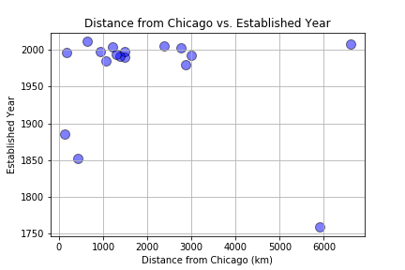
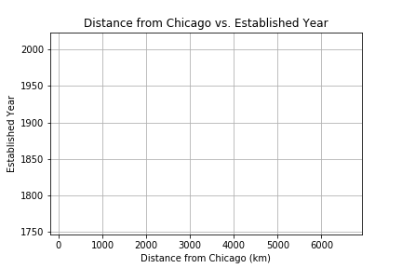
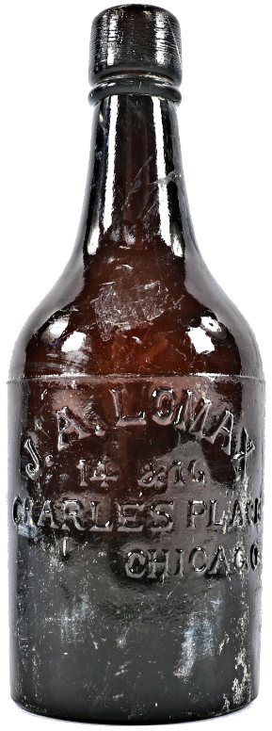
We were interested to see if there is a correlation between the Established Year of a brewery versus it’s Distance from Chicago.
Why Chicago?
Chicago was one of the “hot-spots” for brewing in early America, thanks to the large population of German immigrants living here.
Do we still see a clustering of older breweries closer to Chicago?
With enough time (and prohibition) this trend might no longer exist.
*Hypothetical Data – if the correlation still exists

